Slide 1
Web Interfaces
Complied by -- Ms. Rushita verlekar
BCA

Slide 2
Internet & WWW
The World Wide Web, or simply Web, is a way of accessing information over the medium of the Internet. It is an information-sharing model that is built on top of the Internet.
The Internet is to the World Wide Web as Europe is to France. One is the container, the other is an item within the container.

Slide 3
Browser
A web browser is a software application for retrieving, presenting and traversing information resources on the World Wide Web.
An information resource is identified by a Uniform Resource Identifier (URI) and may be a web page, image, video or other piece of content. Hyperlinks present in resources enable users easily to navigate their browsers to related resources
Eg of url :
https://www.tutorialspoint.com/html5/html5_web_forms2.htm
Eg of uri :
html5/html5_web_forms2.htm

Slide 4
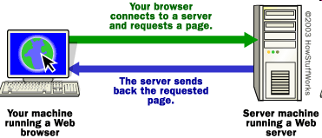
Communication on the Web
Web Pages & HTML
1.<number>
© 2009, SDCCE

Slide 5
Characteristics of a good web site
Well-organized
Easy to navigate
Attractive
Useful
Up-to-date

Slide 6
What is HTML ?
HTML stands for Hyper Text Markup Language which is used for creating web pages and web applications.
Hyper Text: HyperText simply means "Text within Text." A text has a link within it, is a hypertext. Whenever you click on a link which brings you to a new webpage, you have clicked on a hypertext. HyperText is a way to link two or more web pages (HTML documents) with each other.
Markup language: A markup language is a computer language that is used to apply layout and formatting conventions to a text document. Markup language makes text more interactive and dynamic. It can turn text into images, tables, links, etc.
Web Page: A web page is a document which is commonly written in HTML and translated by a web browser. A web page can be identified by entering an URL. A Web page can be of the static or dynamic type. With the help of HTML only, we can create static web pages.

Slide 7
What is HTML5 ?
HTML5 is a next version of HTML. Here, you will get some brand new features which will make HTML much easier. These new introducing features make your website layout clearer to both website designers and users. There are some elements like <header>, <footer>, <nav> and <article> that define the layout of a website.
Why use HTML 5:
  It allows you to play a video and audio file.
  It allows you to draw on a canvas.
  It facilitate you to design better forms and build web applications that work offline.
  It provides you advance features for that you would normally have to write JavaScript to do.
  The most important reason to use HTML 5 is, we believe it is not going anywhere. It will be here to serve for a long time according to W3C recommendation.

Slide 8
Example of HTML.
<!DOCTYPE>
<html>
<head>
<title>Web page title</title>
</head>
<body>
<h1>Write Your First Heading</h1>
<p>Write Your First Paragraph.</p>
</body>
</html>
Basic steps to create a HTML page:
(pre requisite)
Any Text editor such as notepad, Notepad++, Editplus, Textmate, Dream weaver
Modern browsers such as Firefox 3.5 +, IE9, chrome, safari
Steps
Type the html code in a text editor
Save the file name as fielname.html(use html extension)
Go to the file location.
Double click on the file or go to a browser type the file location in location bar.

Slide 9
Description of HTML Example
<!DOCTYPE>: It defines the document type or it instruct the browser about the version of HTML.
<html > :This tag informs the browser that it is an HTML document. Text between html tag describes the web document. It is a container for all other elements of HTML except <!DOCTYPE>
<head>: It should be the first element inside the <html> element, which contains the metadata(information about the document). It must be closed before the body tag opens.
<title>: As its name suggested, it is used to add title of that HTML page which appears at the top of the browser window. It must be placed inside the head tag and should close immediately. (Optional)
<body> : Text between body tag describes the body content of the page that is visible to the end user. This tag contains the main content of the HTML document.
<h1> : Text between <h1> tag describes the first level heading of the webpage.
<p> : Text between <p> tag describes the paragraph of the webpage.

Slide 10
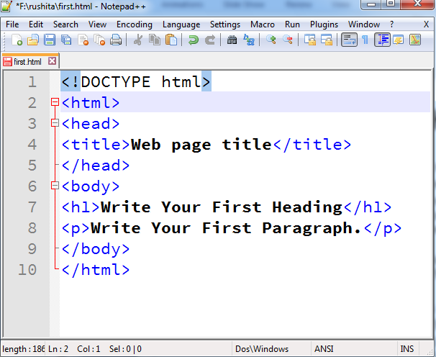
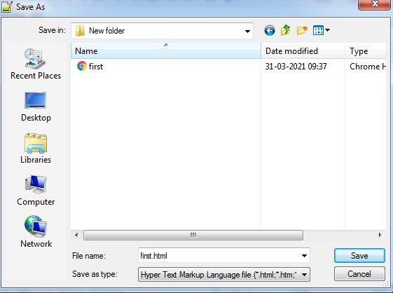
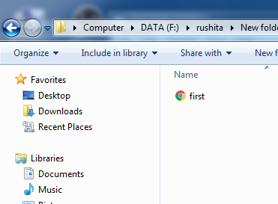
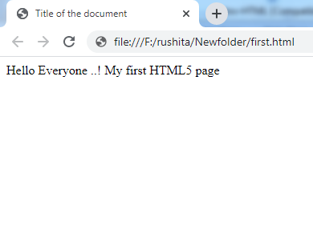
Steps to create and save a file
Step 1
Step 2
Step 3
Step 4

Slide 11
Building blocks of HTML
An HTML document consist of its basic building blocks which are:
Tags: An HTML tag surrounds the content and apply meaning to it. It is written between < and > brackets.
Attribute: An attribute in HTML provides extra information about the element, and it is applied within the start tag. An HTML attribute contains two fields: name & value.
Elements: An HTML element is an individual component of an HTML file. In an HTML file, everything written within tags are termed as HTML elements.

Slide 12
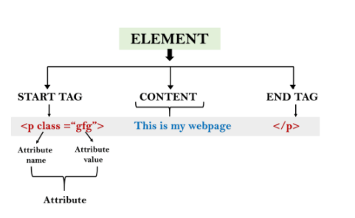
Building blocks of HTML
Syntax :
<tag name attribute_name= " attr_value"> content </ tag name>

Slide 13
HTML Tag
<!DOCTYPE html>
<html>
<head>
<title>The basic building blocks of HTML</title>
</head>
<body>
<h2>The building blocks</h2>
<p>This is a paragraph tag</p>
<p>The style is attribute of paragraph tag</p>
<span>The element contains tag, attribute and content</span>
</body>
</html>
Closing Tag
Opening Tag

Slide 14
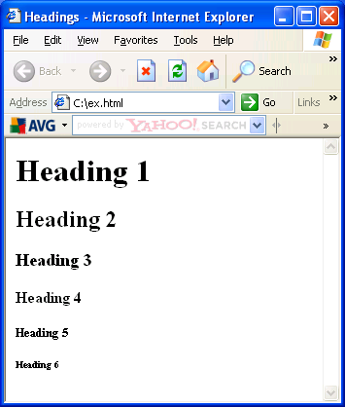
Headings Tag
Some of the most important tags within the body of a HTML document
The tags for a heading are <hy> ...</hy>
y is the size of the heading and ranges from 1 (largest) to 6 (smallest)
Code:
<!DOCTYPE html>
<html>
  <body>
  <h1>Heading 1</h1>
  <h2>Heading 2</h2>
  <h3>Heading 3</h3>
  <h4>Heading 4</h4>
  <h5>Heading 5</h5>
  <h6>Heading 6</h6>
  </body>
</html>

Slide 15
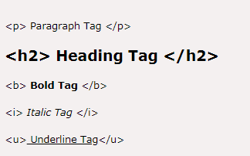
More HTML Tag

Slide 16
HTML Attribute
HTML attributes are special words which provide additional information about the elements or attributes are the modifier of the HTML element.
Each element or tag can have attributes, which defines the behaviour of that element.
Attributes should always be applied with start tag.
The Attribute should always be applied with its name and value pair.
The Attributes name and values are case sensitive, and it is recommended by W3C that it should be written in Lowercase only.
You can add multiple attributes in one HTML element, but need to give space between two attributes.
<!DOCTYPE html>
<html>
<head>
</head>
<body>
<h1> This is Style attribute</h1>
<p style="height: 50px; color: blue">
It will add style property in element
</p>
<p style="color: red">It will change the color of content </p>
</body>
</html>

Slide 17
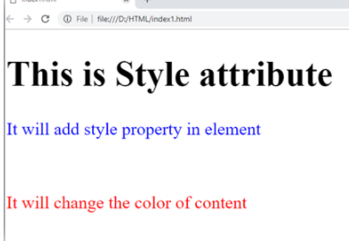
HTML Attribute
<p style="height: 50px; color: blue">
It will add style property in element
</p>
In the above statement, we have used paragraph tags in which we have applied style attribute. This attribute is used for applying CSS property on any HTML element. It provides height to paragraph element of 50px and turns it colour to blue.
<p style="color: red">It will change the color of content</p>
used style attribute in paragraph tag, which turns its colour red.
Output :

Slide 18
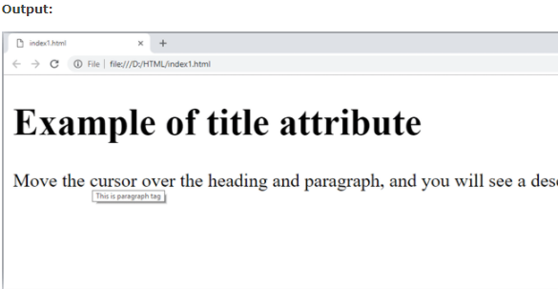
Title attribute
<!DOCTYPE html>
<html>
<head>
</head>
<body>
<h1 title="This is heading tag">
Example of title attribute</h1>
<p title="This is paragraph tag">
Move the cursor over the heading and paragraph, and you will see a description as a tooltip
</p>
</body>
</html>

Slide 19
The href attribute in HTML
The href attribute is the main attribute of <a> anchor tag. This attribute gives the link address which is specified in that link. The href attribute provides the hyperlink, and if it is blank, then it will remain in same page.
<a href="www.javatpoint.com/html-anchor">This is a link</a>
<a href=“F://abc.html">This is a link</a>

Slide 20
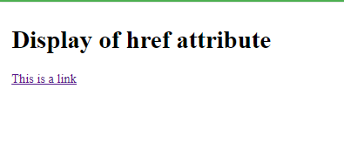
The href attribute in HTML
output :
<!DOCTYPE html>
<html>
<head>
</head>
<body>
<h1>Display of href attribute</h1>
<a href=“ myfile.html ”>This is a link</a>
</body>
</html>
Anchor
Location of resource / action file
Eg: abc.html
Google.com Anchor

Slide 21
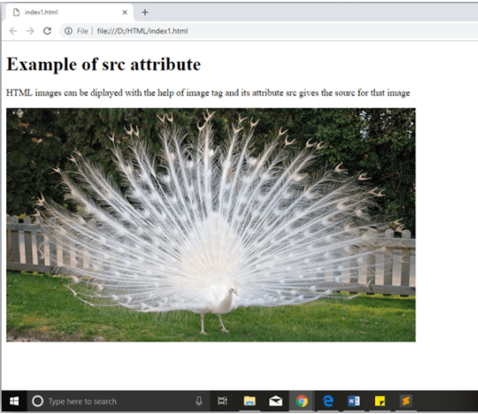
Image tag and src Attribute
<img src="whitepeacock.jpg" height="400px" width="600“/>
The src attribute is one of the important and required attribute of <img> element. It is source for the image which is required to display on browser. This attribute can contain image in same directory or another directory. The image name or source should be correct else browser will not display the image.
Note : The example also have height and width attribute, which define the height and width of image on web page.

Slide 22
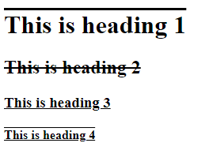
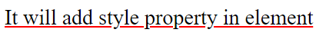
Some styles values for style=“ ...”
color: blue; (any color)
font-style: italic; (italic/bold/normal)
font-size: 25px;
text-decoration: underline; (overline/line-through/underline overline)
text-decoration-color: red;
text-align: center; (center/right/left)
Example for text-decoration and text-decoration-color :red
Example for text-decoration

Slide 23
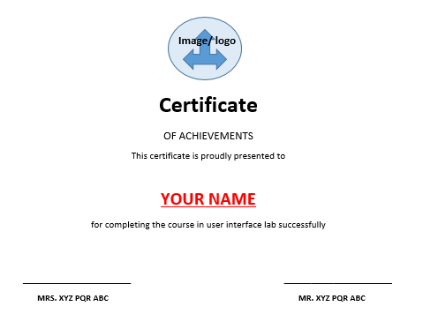
Exercise
&nbsp; &nbsp;&nbsp;&nbsp;
Design a certificate using HTML. Using style tag for styling

